Slide 1

Real Estate Market Analysis in USA (CA)
Ashlesh Khajbage

Slide 2
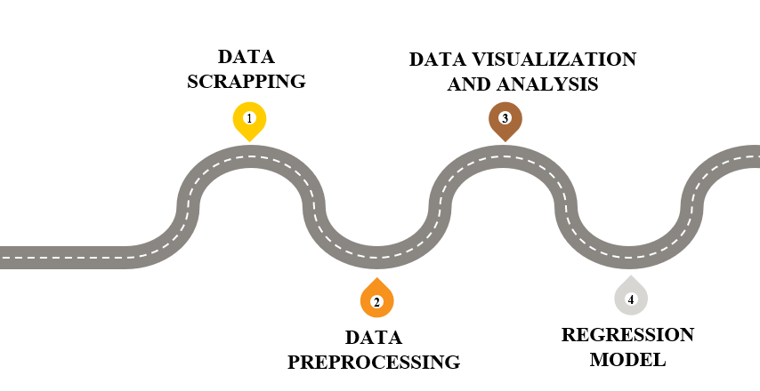
Agenda

Slide 3
Objectives
Every individual need to deal with the real estate or housing market at certain point of time in life. Having a good overview on the market will help in buying or selling the house in the market at right price.
In our project we will be doing exploratory data analysis and prediction on housing prices at various cities in the Bay Area such as Fremont, South San Francisco, San Mateo, Burlingame, Palo Alto, Santa Clara, Cupertino, Milpitas etc. that are listed on Zillow.

Slide 4

DATA SCRAPING

Slide 5




WEB SCRAPING PROCESS – DATA COLLECTION
Zillow | AreaVibes | Modules - Urllib, Beautiful Soup, requests
01
02
03
04
05
Scrapping Individual House data from listings
Getting house listings and links
Creating Data Frames
Ratings
Storing Data in Data Frames
Getting the houses listed for each area (first 2 pages)
Scrapping details like facts & features, schools, price history using beautiful soup
Creating data frames
Zillow – Basic Info of the house
Facts – Facts & Features
Price History – Price history of each house
Getting ratings for schools, crimes, employment and livability from Area vibes
All scrapped data is converted to data frames and stores as CSV files

Slide 6











DATA COLLECTION
Data Is collected from various websites by scrapping & downloads
WEBSITES
Zillow
Zillow
AreaVibes
Zillow to get all houses listed and respective facts & features ,price history etc.
Timeseries Data for all states in USA and California counties& Cities
Areavibes data for each city to get employment ,crime and schools ratings
Zillow
Facts & Features
Price History
All States
California Cities
Ratings

Slide 7

Data Preprocessing

Slide 8

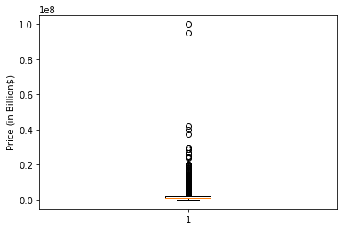
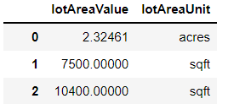
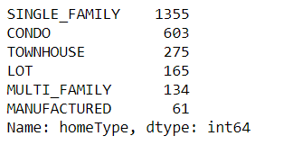
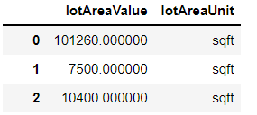
DATA PREPROCESSING
1
Dropping unwanted Columns
2
Removing Outliers
3
Removing House Types
4
Data Format and Conversions
Purpose:
Dropping columns that are not required for analysis
Applied on:
Zillow
Facts
Price History
Purpose:
Outlier will give biased results during analysis and model building.
Applied on:
Zillow
Facts
Price History
Purpose:
In our case we do not need LOT type of houses for our analysis. So we have dropped rows with house type as LOT.
Applied on:
Zillow
Purpose:
Making sure all values in single column has same datatype and correct format. Ex: Lot Area is acres in acres and sqft.
Applied on:
Zillow ,Facts
Removed house with type as lot
Ex: Outliers for price

Slide 9
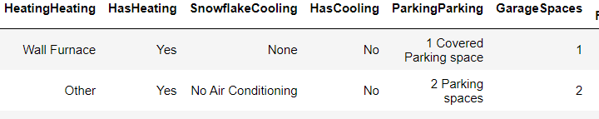
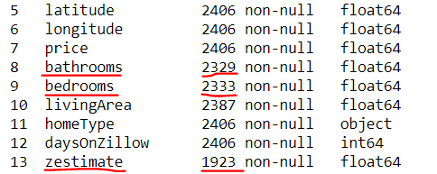
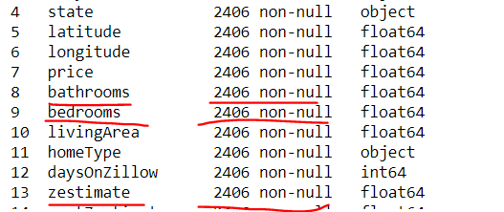
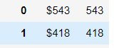
DATA PREPROCESSING
5
Data Imputation and Removal of Nulls
6
Data Manipulation and Dropping Duplicates
7
Merging Data Frames
Purpose:
Data Does not necessarily comes cleaner, so imputing null values with mean and mode help in avoiding nulls.
Nulls in Zestimate are replaced by original price.
Applied on:
Zillow,Facts
Purpose:
Manipulating data so that the data can be used for analysis and building regression models.
Converting the datatypes of few columns from float to int ,like bedrooms, bathrooms, year built etc.
Checking for duplicates and dropping duplicates
Applied on:
Facts
Purpose:
Merging data frames after data preprocessing to create a big data frame with all the data.
Inner join on Zillow and making sure
Applied on:
Zillow and Facts
Price History and Zillow
Price per sqft

Slide 10

Data Visualization and Analysis

Slide 11
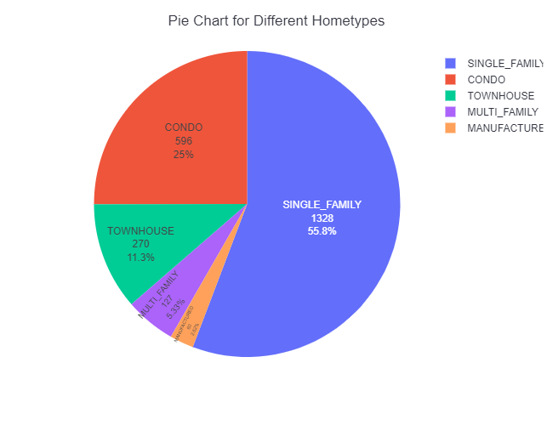
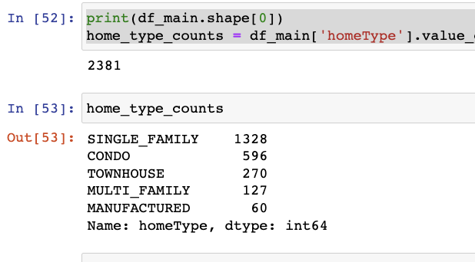
Most Popular Home Type
Work 🔨:
Install plotly.express for better visualization
Value count on home type column and plot pie chart
Analysis💡:
With 55.8%, single family is the most popular home type in the Bay Area on Zillow.
Following are condo and townhouse which contribute 25% and 11.3% of home type, respectively
Multi family is pretty minor with 5.3%
Manufactured is the less popular home type with 2.5%. This is predictable because the Bay Area one of the most expensive regions of the state

Slide 12
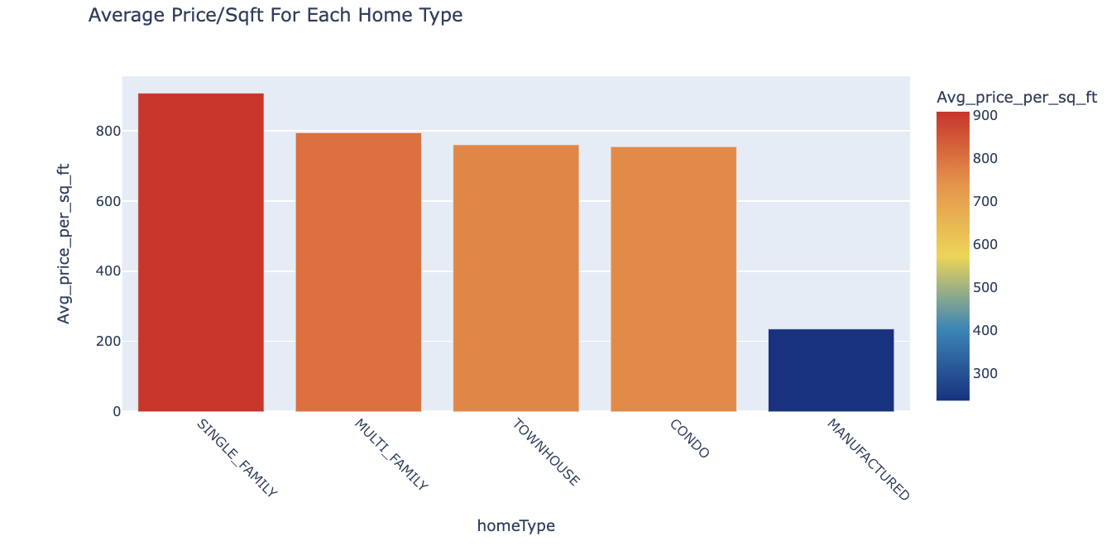
Average Price/ Sqft For Each Home Type
Work 🔨:
Home type and price/sqft details were used; Grouped them by home type.
Calculate average price/sqft for each home type
Analysis💡:
Single Family_ the most popular home type has the highest average price/sqft being $907/sqft
Following is townhouse and condo for approximately $755/sqft
Multi family is just around $30/sqft less than townhouse and condo
Manufactured is the cheapest home type in the bay area for $236/sqft

Slide 13





3 BEDS AND 2 BATHS

Slide 14
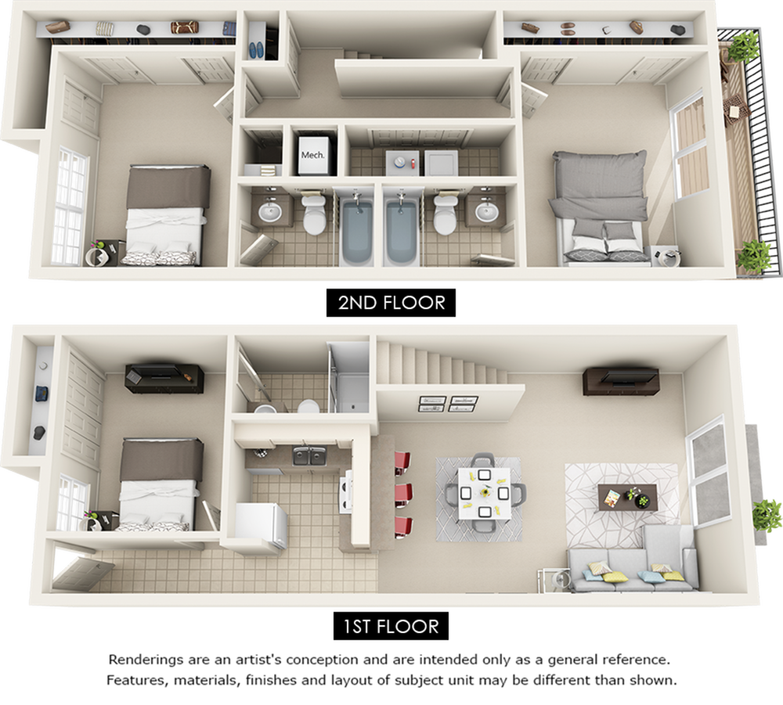

The Average Price For 3 Bedrooms And 2 Bathrooms In The Bay Area
As of May 20, 2023, there are 473* houses on Zillow with 3 bedrooms and 2 bathrooms in the Bay Area
The average price is $ 1,426,921
$ 1,426,921
(* used only limited information from zillow)

Slide 15
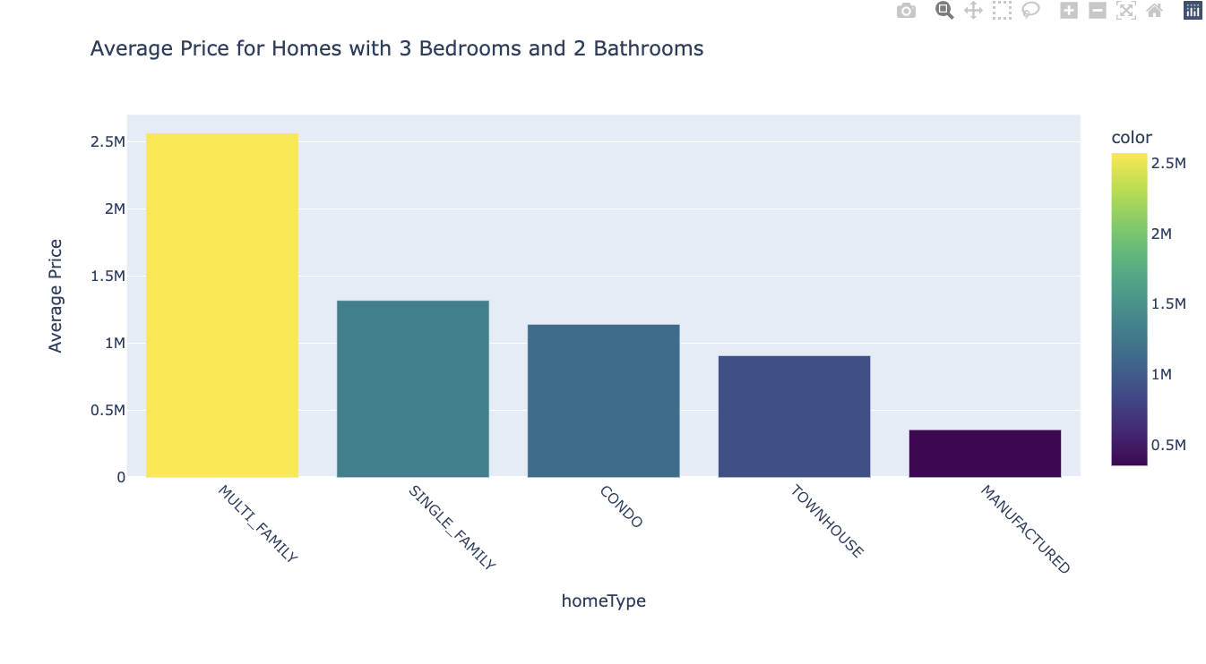
Average Price For 3 Bedrooms And 2 Bathrooms
For Different Home Type
Work 🔨:
Price and home type of all the houses with 3 bed and 2 bath were used
Grouped them by home type and average housing price was calculated
Analysis💡:
Multi family is the most expensive. It costs on average ~ 2.5 million dollars
Following are single family and condo for approximately 1.2 million dollars
Townhouse and Manufactured are the cheapest

Slide 16
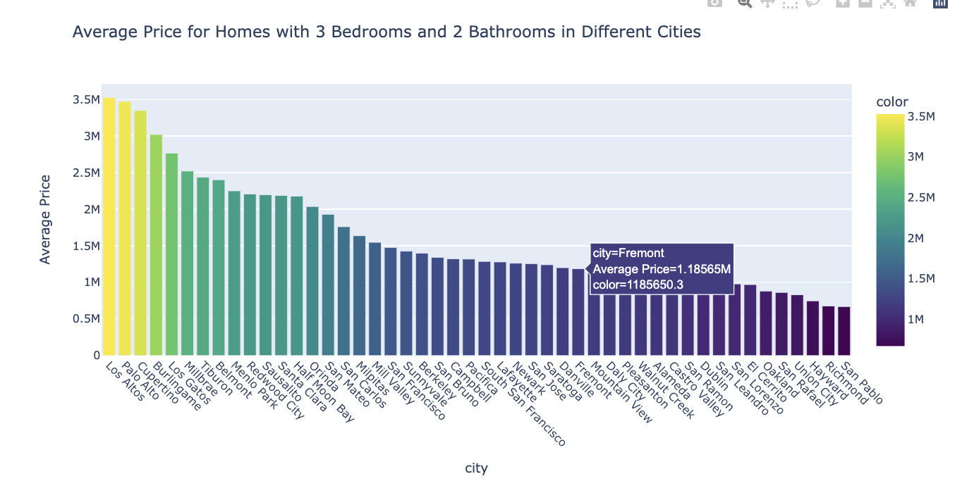
Average Price For 3 Bedrooms And 2 Bathrooms
In Different Cities

Slide 17
Average Price For 3 Bedrooms And 2 Bathrooms
In Different Cities
Less than 800,000:
Hayward
Richmond
San Pablo
Around 1 million dollar
Mountain View
Daly City
Pleasanton
Walnut Creek
Alameda
$$
$
Around 2 millions:
Redwood City
Sausalito
Santa Clara
Half Moon Bay
Orinda
$$$$
$$$
Over 3 millions:
Los Altos
Palo Alto
Cupertino
Burlingame

Slide 18
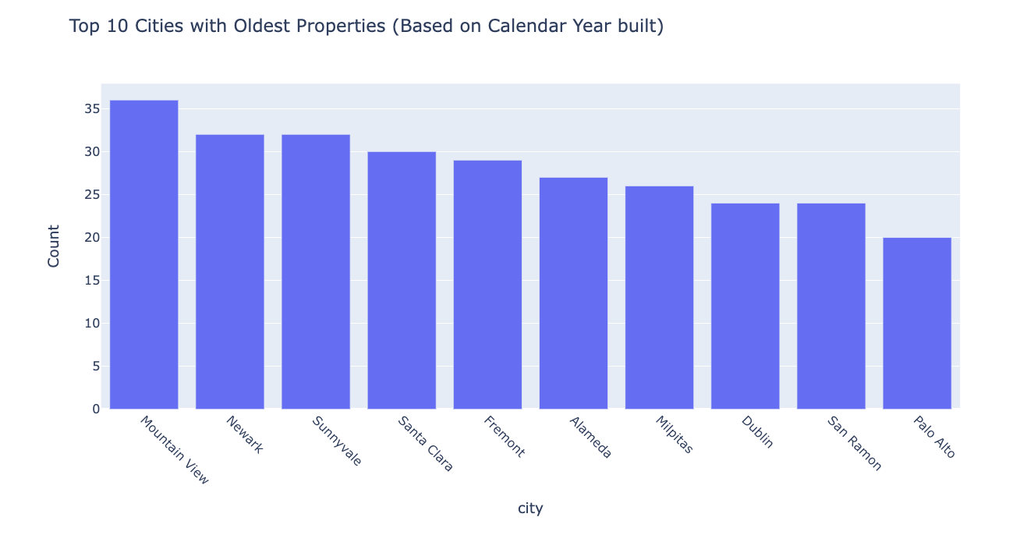
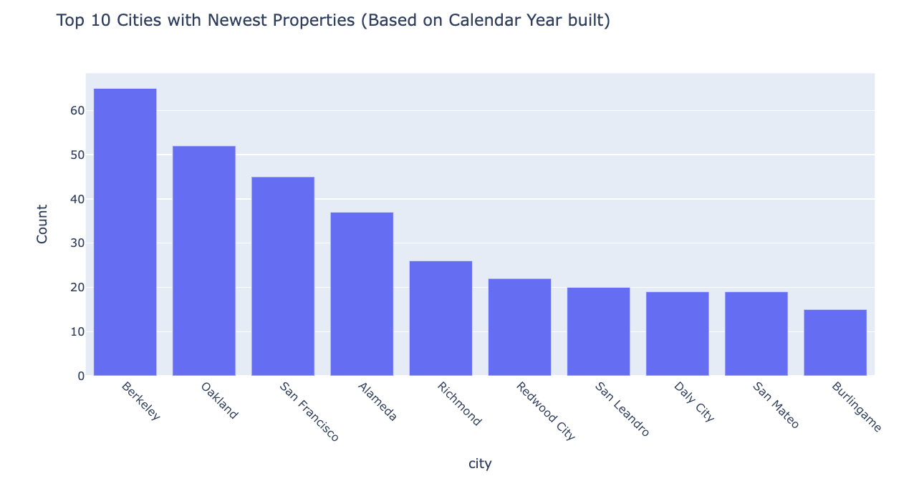
Cities with oldest and newest properties
Work 🔨:
'Calendar Year built' and city information was used
Sorted the data frame based on 'Calendar Year built' in a descending order
Considered top and bottom 500 rows; Grouped them on city separately.
Analysis💡:
Mountain View has the most number of old properties
Berkeley has the most number of new properties

Slide 19
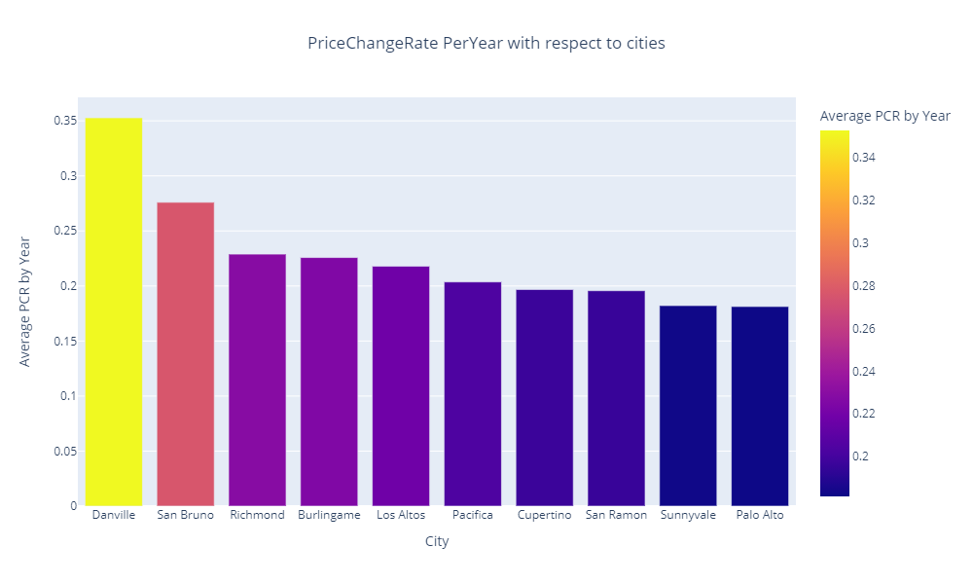
Appreciation rate with respect to city
Work 🔨:
First and last events happened on all properties were identified
Time gap(in years) and price change between these two events was calculated
Price change rate per year was calculated
Grouped the results by city and calculated the mean
Top 10 cities were considered
Analysis💡:
Danville has the highest appreciation rate of 35% per year
Palo Alto has the lowest appreciation rate of almost 20% per year (among top 10 cities)

Slide 20
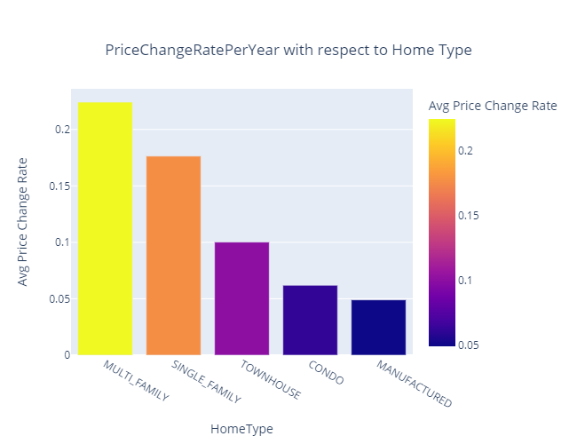
Appreciation rate with respect to home type
Work 🔨:
First and last events happened on all properties were identified
Time gap(in years) and price change between these two events was calculated
Price change rate per year was calculated
Grouped the results by home type and calculated the mean
Analysis💡:
Prices of 'Multi family' type homes are increasing the most, which is 22% per year
'Single family' and 'Town houses' are next in line

Slide 21
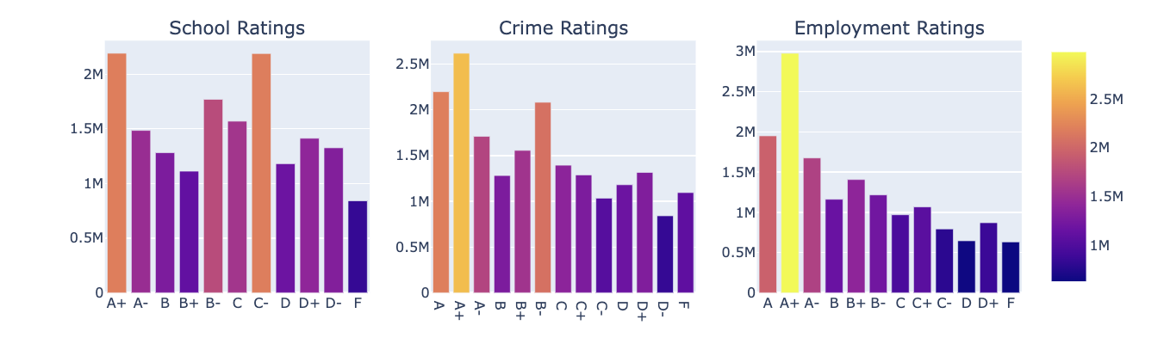
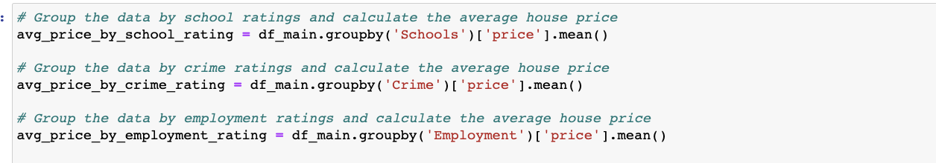
Impact of Crime Rates, School ratings and Employment opportunities on housing prices in Bay Area

Slide 22
Impact of Crime Rates, School ratings and Employment opportunities on housing prices in Bay Area
Work 🔨:
School, crime and employment ratings for all the houses were considered along with the price details.
Then calculated the average house prices by grouping the school, crime and employment details separately.
Rating Vs average price bar charts were plotted for each category
Analysis💡:
Cities that have ratings in 'A', have a higher price range of houses.
Areas with better Employment ratings matter the most and have highest range of house prices.
Crime rating can be considered as a second priority while house hunting.

Slide 23
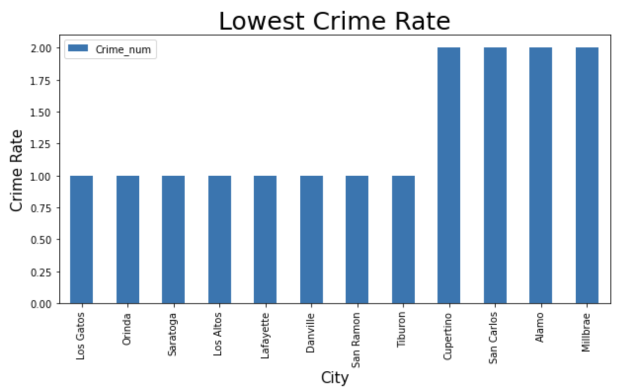
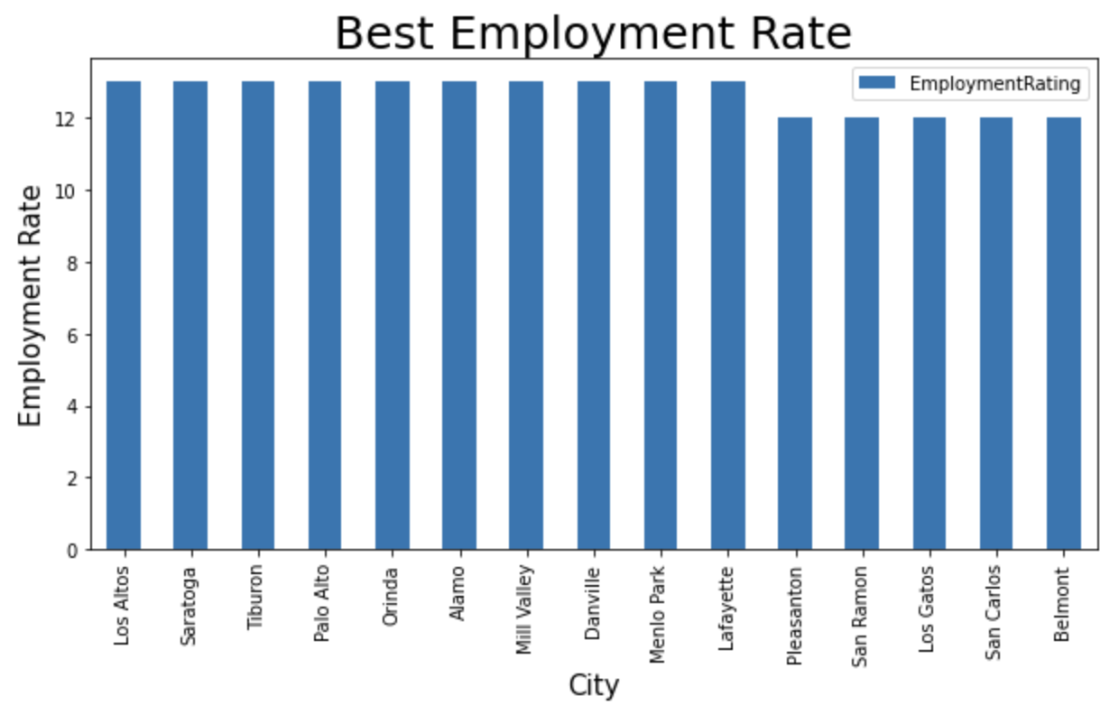
City/Cities with lowest Crime Rate and Best Employment Rates

Slide 24
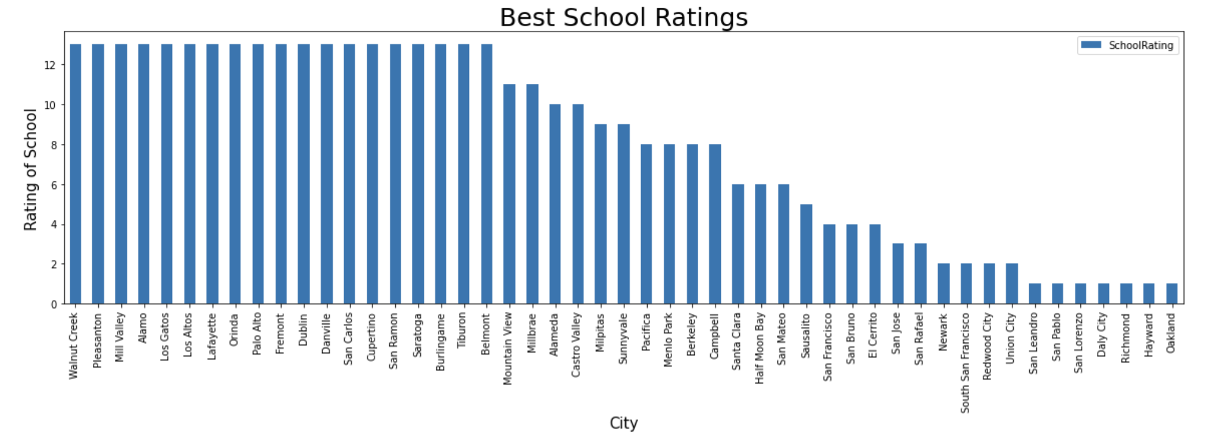
Cities with highest to lowest school ratings

Slide 25
Cities with highest to lowest school ratings
Work 🔨:
Grouped by cities and calculated average crime, school and employment ratings for each city
Plotted bar charts for crime, school and employment ratings with respect to city
Analysis💡:
Los Gatos, Orinda, Saratoga, Los Altos, Lafayette, Danville, San Ramon, Tiburon are the safest cities of Bay Area.
Los Altos, Saratoga, Tiburon, Palo Alto, Orinda, Alamo, Mill Valley, Danville, Menlo Park, Lafayette are the cities with highest employment ratings.
Walnut Creek, Pleasanton, Mill Valley, Alamo, Los Gatos,Los Altos, Lafayette, Orinda, Palo Alto, Fremont, Dublin, Danville, San Carlos, Cupertino, San Ramon, Saratoga, Burlingame, Tiburon, Belmont are the cities with highest school ratings.

Slide 26
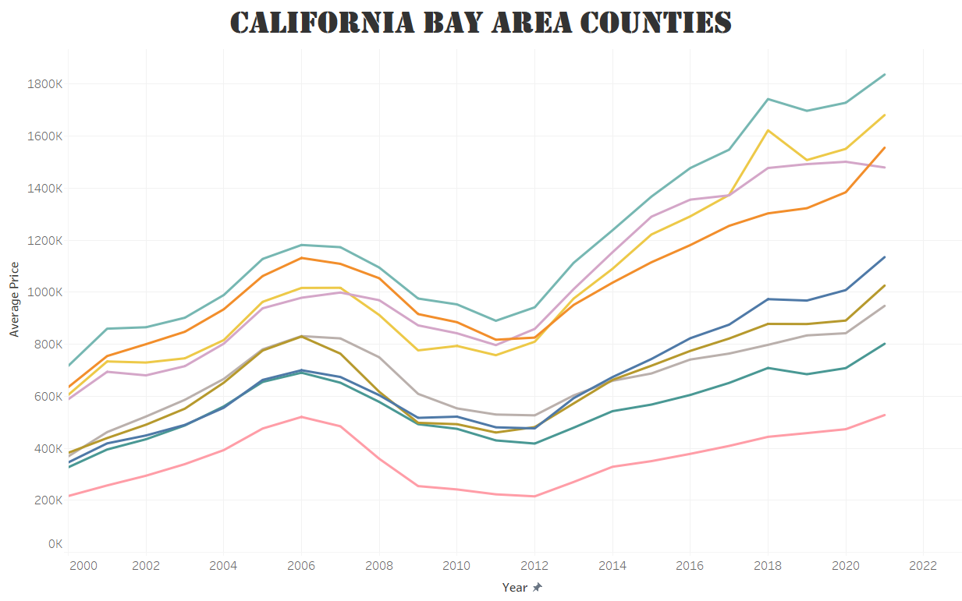
Real estate in the Bay Area
Work 🔨:
Year and Average prices with respect to each year and county information was used
Analysis💡:
All the counties had an increase in the average prices of properties from 2000 to 2006.
Later, all the counties have seen a downtrend in the average house prices from the end of 2006 to 2012 due to economic recession.
After that, the average prices have again started to increase

Slide 27
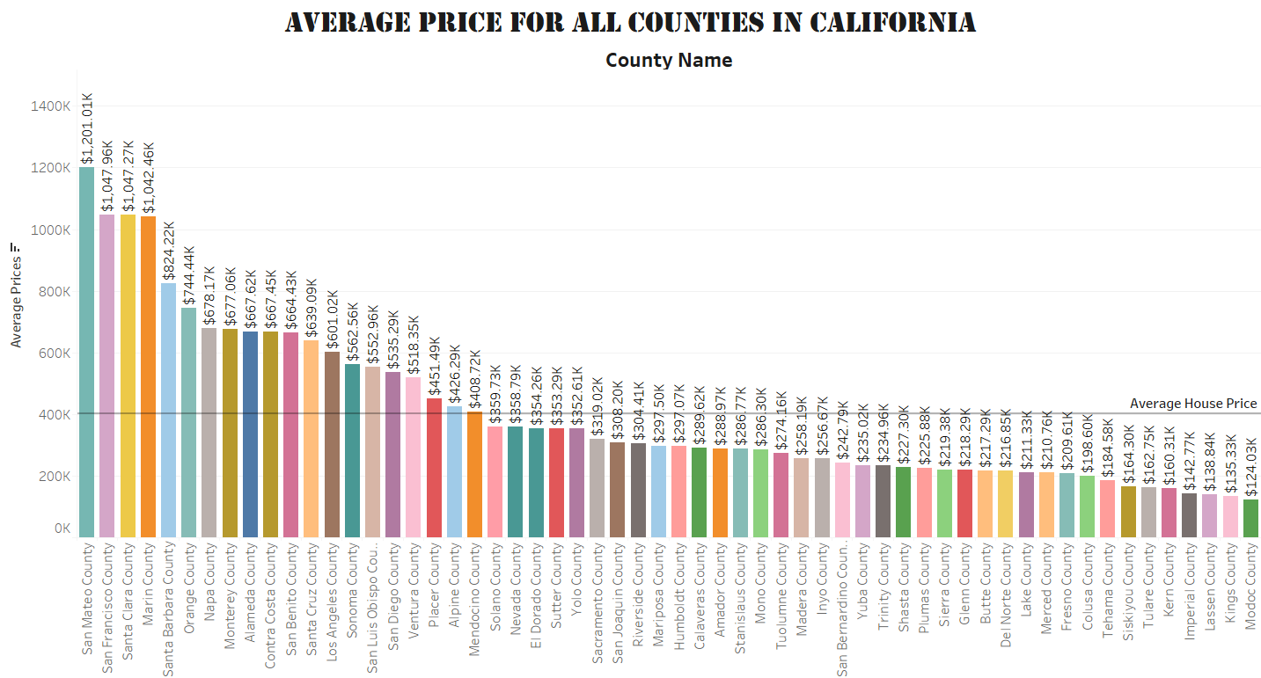
Average housing prices for all counties in California
Work🔨:
All the counties in CA and Average Prices of each county
information was used
Arranged in the descending order of Average price
Analysis💡:
San Mateo County has the highest Average pricing
Modoc County has the lowest average pricing

Slide 28
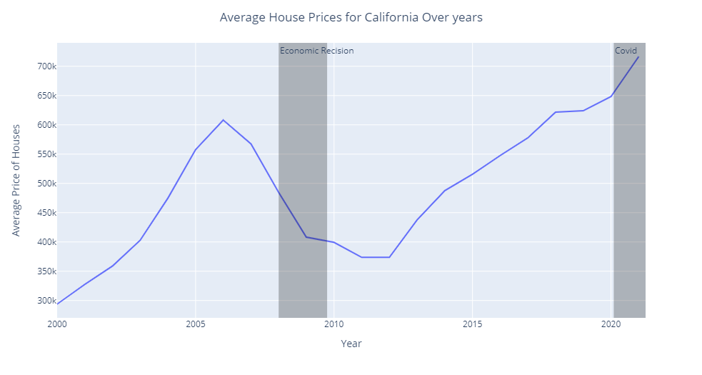
Trend in the housing prices over years in California
Work 🔨:
Grouped by year and calculated the average prices of properties
Analysis💡:
An increasing trend has been observed from 2000 till 2006.
Downfall from 2006 to 2011.
Since 2012 till date a tremendous increase in the prices can be observed clearly.

Slide 29
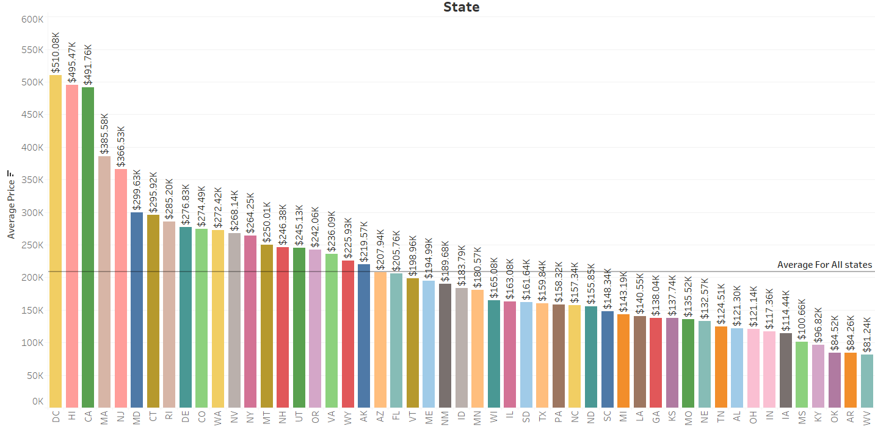
Mean Housing prices in all states of U.S
Analysis💡:
Among all the states in the U.S, DC has the highest average housing price
West Virginia has the least average housing price

Slide 30

How did housing prices change since the lockdown?
Work🔨:
Mean price change rate for each city were captured for 2 years from Mar 19,2018 to March 18,2020 (before lockdown)and for 1.5 years from Mar 19,2020 to until now (after lock down).
For each city in bay area, calculated the average mean price change rate before and after March 19,2020.

Slide 31
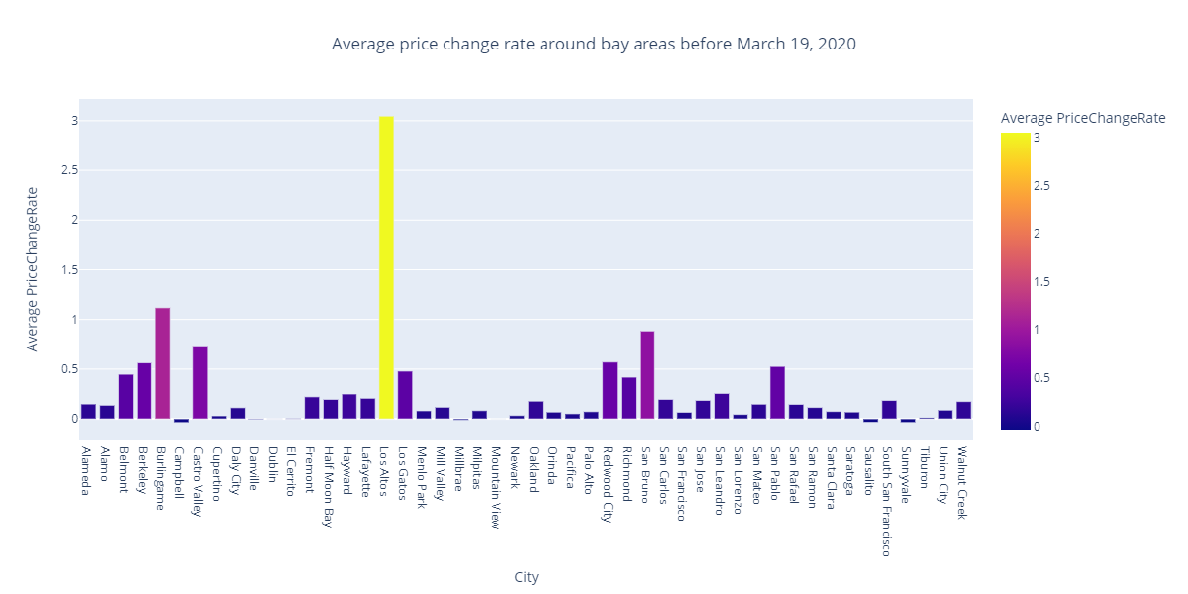
Pre - Lockdown (March 19, 2018 to March 18, 2020)

Slide 32
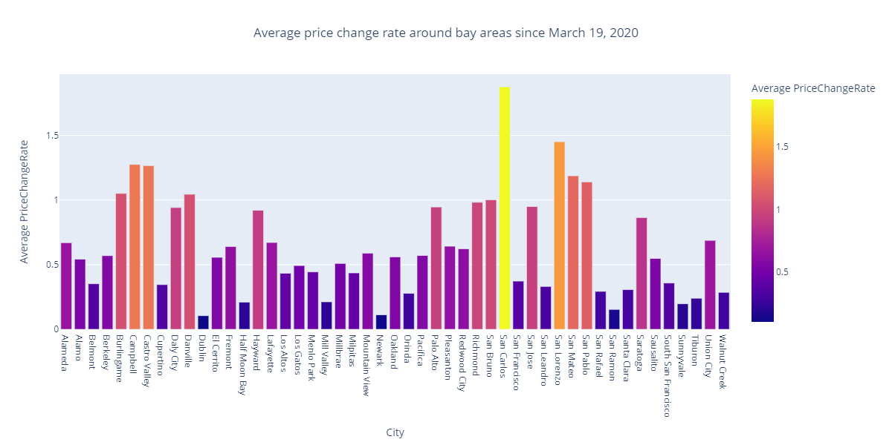
During Lockdown (March 19, 2020 onwards)

Slide 33
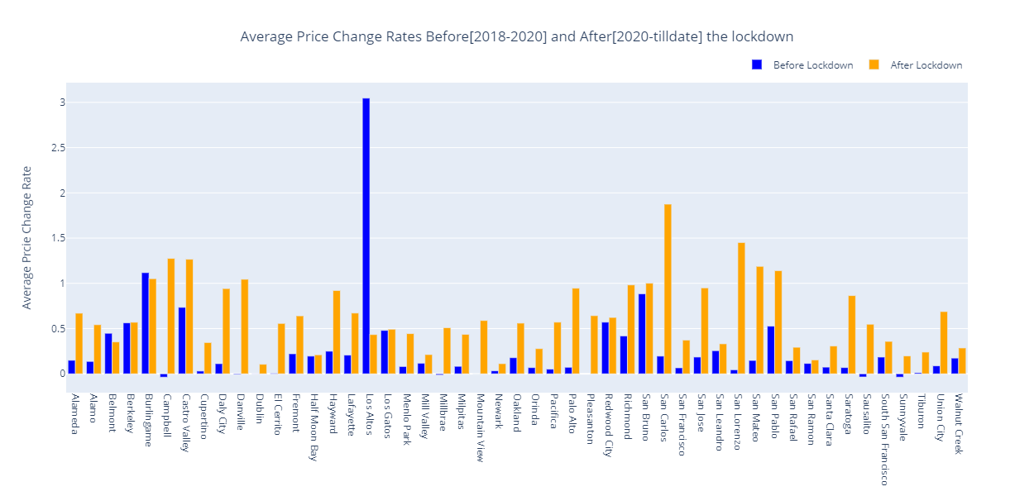
Comparing data before and After Lockdown

Slide 34
Comparing data before and After Lockdown
Analysis💡:
Comparing average price change rate for data before and over the period of stay-at-home (i.e, March 19, 2020) , it can be observed that almost all the cities changed their housing prices during lockdown, except Belmont, Burlingame, Los Altos where they decreased the same.

Slide 35
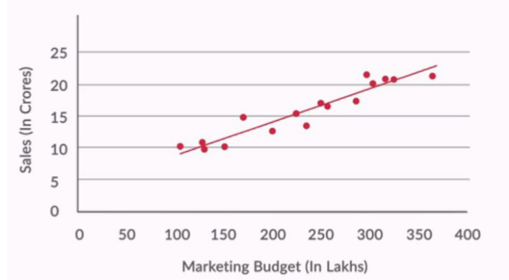
REGRESSION
Regression is finding the best fit straight line between the dependent variable (Y) and independent variable. The output variable to be predicted is a continuous variable.
Y = β0 + β1*X 🡪 Single Independent Variable
Y = β0 + β1*X1 + β2*X2 +….. βn*Xn 🡪 n Independent Variables
The best-fit line is found by minimizing the expression of RSS (Residual Sum of Squares) which is equal to the sum of squares of the residual for each data point in the plot. Residuals for any data point is found by subtracting predicted value and actual value.
R-Square is the amount variability in Y (dependent variable ) is explained by independent variable(s) X.Usually higher R2 value means the model is good in capturing the variance of Y with respective to X.

Slide 36

REGRESSION PIPELINE
Identifying Features & Data Validation
Scaling & Encoding Categorical Variables
Validating Model & Fine Tuning
Feature selection is one of the most prominent step in any model building. In this step we will select only the features that contribute to the model.
Check for null values or if there are any outliers in the data. Regression models are sensitive to outliers.
Any Machine learning Model needs inputs in numerical type to build data.
One Hot Encoding or Ordinal Encoder
Scaling is required for numerical data so that the cost function gradient will decent fast.
Once model is built it should be validated with test data and compared against the test data to calculate R2 and mean square error.
Once these metrics are calculated. Features are dropped based on how much they are contributing to model. This help in more accurate predictions
02
04
06
01
03
05
Test-Train Split
Building Model
Deployment
It is important that data is split into test and train set and Model is trained on only train data. Test data is used to evaluate the model and fine tune the model.
Creating a pipeline for model to run on training data. In this project we have used s
Once the Model is fine tuned it can be deployed for predicting house prices

Slide 37
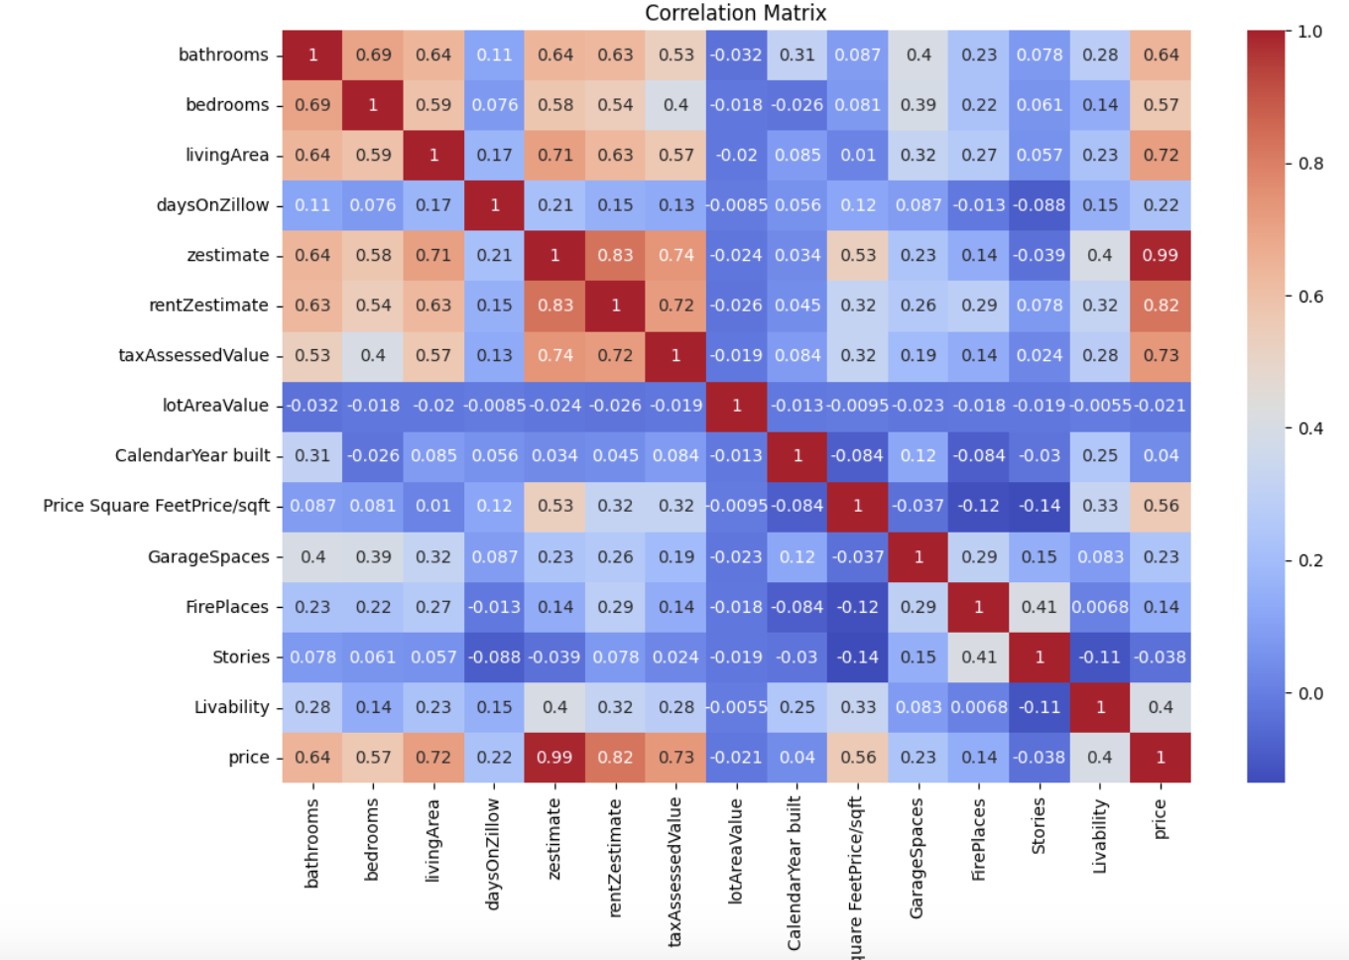
Correlation Heat Map

Slide 38
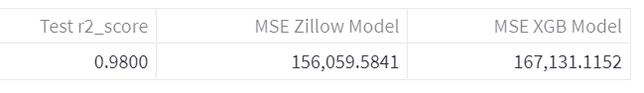
Metrics
Below are the metrics for the XGBoost model,r2 score close to 98 which indicates that model is able to capture Of the variance in y using the features. The mean square error for Zillow model is 156k and mean square error of XGB model is 167k.

Slide 39
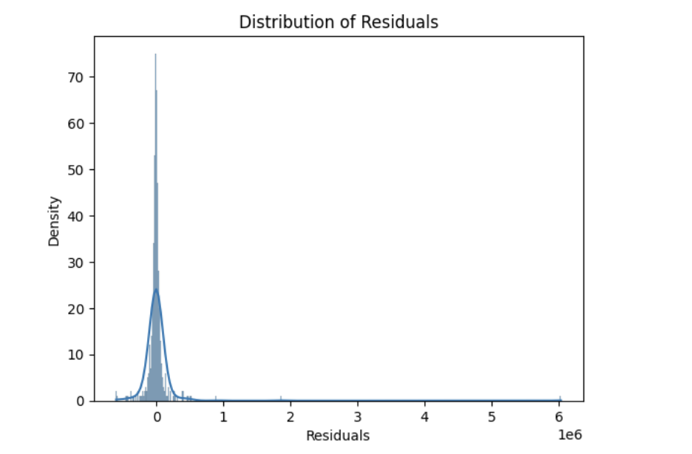
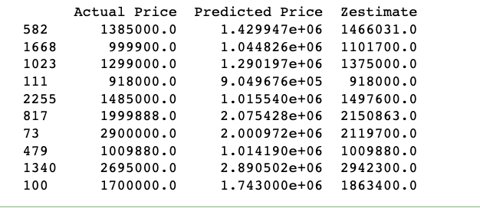
Residuals
Price Predictions for few houses
Distribution of residuals

Slide 40
GITHUB Repository : https://github.com/Ashleshk/Data-Science-Zillow-Real-Estate-Market-Analysis
Thank You

